Slide 1
CS 4974 Independent Study
10/31/22 meeting
Student: Bug Lee

Slide 2
Last time, we discussed…
Dividing syntax/semantic analysis and code generation to separate steps
Suggestion on how to build a parse tree and how to walk the tree using the visitor design pattern

Slide 3
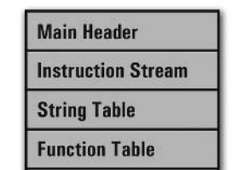
Week 9
(Goal is to implement working compiler by week 11)
compiler
assembler
script.source
script.assembly
script.executable
Virtual Machine
CPU

Slide 4
Abstract Syntax Tree

Slide 5
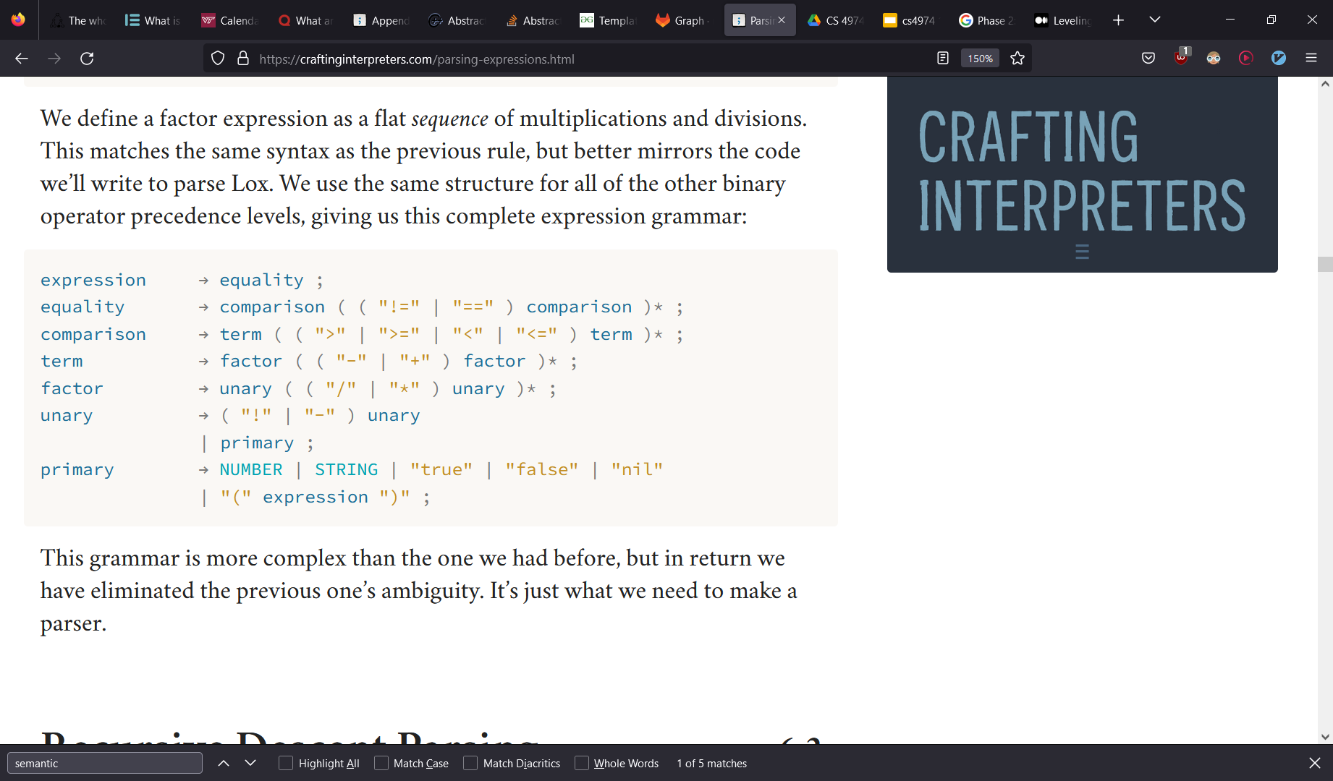
Follow the Grammar rule!

Slide 6
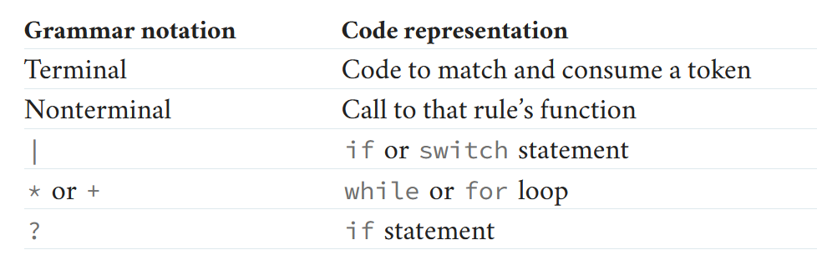
Follow the Grammar rule!

Slide 7
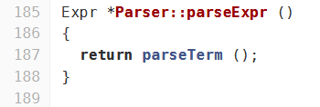
Follow the Grammar rule!

Slide 8
Follow the Grammar rule!

Slide 9
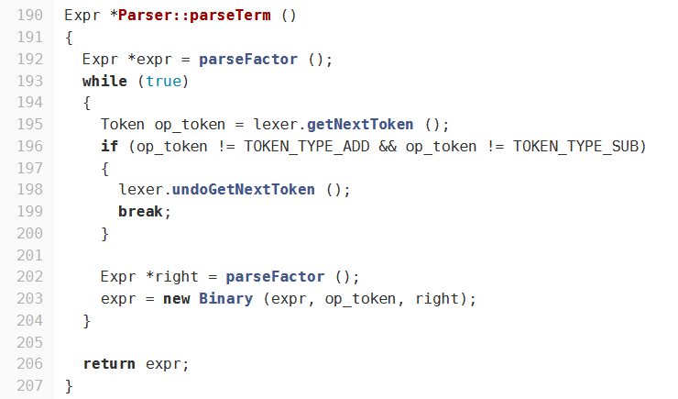
Follow the Grammar rule!

Slide 10
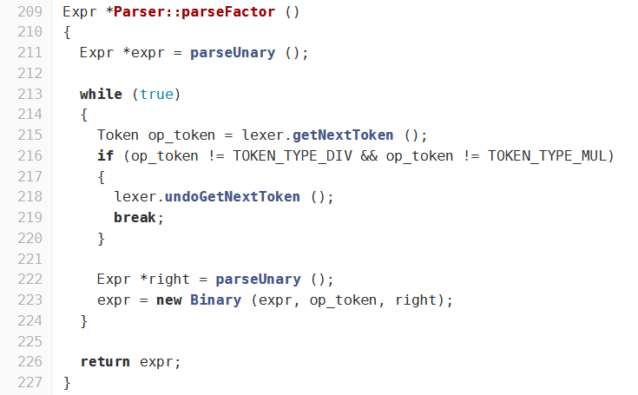
Follow the Grammar rule!

Slide 11
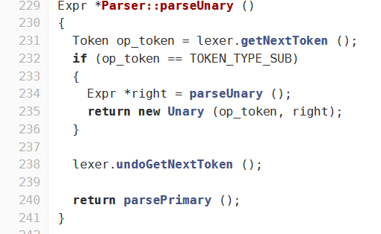
Follow the Grammar rule!

Slide 12
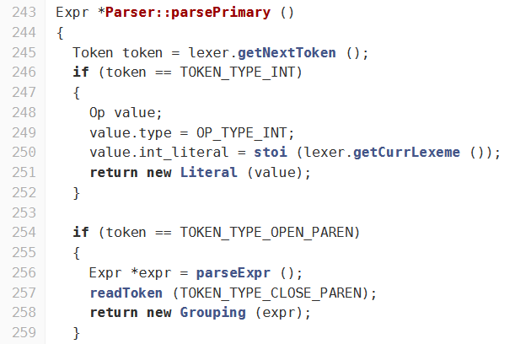
Follow the Grammar rule!

Slide 13
Data structure for AST
Expr
Grouping
Binary
Unary
Literal
Accept (Visitor)
Accept (Visitor)
Accept (Visitor)
Accept (Visitor)
Visitor
VisitGrouping (Grouping)
VisitBinary (Binary)
VisitUnary (Unary)
VisitLiteral(Literal)

Slide 14
AST Demo

Slide 15
Plan for week 10
Continue Compiler parser implementation.
Support statement parsing
Remaining operators (relational, bitwise, and logical)
Variable and array
Function call
Start semantic analyzer and code generator
Converting ast_printer to semantic analyzer

